Slide 1
SK for 1P
PRESO 1.0.0
The Semantic Kernel Team
February 2023
FOR 1P DEV + PRODUCT LEADERS

Slide 2
What’s the TL;DR of this burning moment in technology?
Large Language Model (LLM) advances have made semantically-rich AI into the big “switch” of this decade.
We’re shipping as many GPT-enabled features as we can. How we do it doesn’t matter right now. But it will.
RIGHT NOW (EXTERNAL)
RIGHT NOW (INTERNAL)
FOR 1P DEV + PRODUCT LEADERS

Slide 3
TL;DR: We’re not in Kansas anymore.
Semantic AI requires a new way of writing code that’s unfamiliar.
The hard things are easy, and the easy things can seem hard.
You soon run into the limits of what it can’t do out-of-the-box.
Calling OpenAI APIs directly means you’re thinking too small.
You need new tools that 10X your value and velocity with AI.
Picture infinite chats, long-running tasks, 900+ connectors.
FOR 1P DEV + PRODUCT LEADERS

Slide 4
Build with common tools to avoid future technical debt.
FROM
TO
Shipping a one-off, iffy GPT feature
Solve problems just with prompts
Struggle to build prompt contexts
Build prompt orchestration yourself
Make prompt libraries on your own
Take a paved path for GPT deploys
Mix prompts with native code
Get vector memory for fast prompts
Use an emerging, common approach
Access stock, ready-to-go prompts
FOR 1P DEV + PRODUCT LEADERS

Slide 5
Tell me … why do I need ”Semantic Kernel”?
TAKE FULL ADVANTAGE OF LLM AI
Work multimodal, across many models seamlessly. Future-proof your code investment.
BOOST YOUR CODING PRODUCTIVITY
Access common LLM AI coding patterns to leverage your peers. Use pre-built skills + connectors.
FOR 1P DEV + PRODUCT LEADERS

Slide 6
Who is the target audience for Semantic Kernel?
That’s you, the developer. Yeah, you. If we all use different approaches to LLM AI, their individual behaviors will not be dependable and repeatable. One-off text completions or summarizations will not bring defensibility to our combined AI efforts. Only a large, engaged set of developers can do so.
And for the customer, it will be h*ll. Our products will have inconsistent “sub-personalities” that will feel like landing at every world city all at once — bumping into different conventions at every point of interaction.
FOR 1P DEV LEADERS

Slide 7
Semantic Kernel pays down future technical debt asap.
💪 THE CORE
Everything you need to manage complex prompts, chains, long-running tasks, and planning.
SKILLS
RUNTIME
PLANNER
…
3
2
1
1
2
3
…
MEMORIES
CONNECTORS
🤯 THE BFD
But wait, there’s more! All the longform memories readily available in the MS Graph. Plus, the 900 Power connectors.
SUBSTRATE
LINKEDIN
GITHUB
POWER PLATFORM
FOR 1P DEV + PRODUCT LEADERS

Slide 8
Meet the lightweight Kernel of Semantic Kernel
“
I’ve been designed to reduce hallucinations, orchestrate complicated LLM AI prompts combined with native code, use multiple AI models, and … I have a special skill to PLAN.”
STEPS
👋
PLANNER
1
2
3
…
ernel
ASK
K
“
I take a user’s ask and generate a step-by-step plan that draws upon available skills.”
Planner generates steps that use available Skills
SKILLS
FOR 1P DEV + PRODUCT LEADERS

Slide 9
SK R1 Tour
Available NOW
ernel
ASK
K
It all starts with a user’s AI ask …
Steps ready from planner
UNDER CONSTRUCTION
1
2
3
…
SUBSTRATE
LINKEDIN
GITHUB
Gather Skills
Gather Contexts
V1 READY
UNDER CONSTRUCTION
Gather Connectors
POWER PLATFORM
SKILLS
… resulting in new productivity
GET
RUNNING STEPS PIPELINE
Result is ready
1
2
3
…
Execute Steps
FOR 1P DEV LEADERS

Slide 10
How to use Semantic Kernel R1 in just 1 minute.
⏱️
1 minute
⏱️
HAVE MORE TIME?
⏱️
MORE MINUTES
Install the nuget package and go
#r "nuget: Microsoft.SemanticKernel, *-*"
Go deeper with the GitHub repo aka.ms/skrepo
Learn more about its history aka.ms/sk
2023 March TL

Slide 11
How to use Semantic Kernel R1 in three steps.
⏱️
5 minutes
⏱️
15 minutes
⏱️
75** minutes OR MORE
Clone the internal repo aka.ms/skrepo
Step through live samples in Jupyter NBs aka.ms/skjupyter
Go deeper with aka.ms/sk
Get supported at aka.ms/sksupport
**4 APP SAMPLES @15 MIN
3 STARTER VIDEOS @5 MIN
For 1P DEV + PRODUCT LEADERS

Slide 12
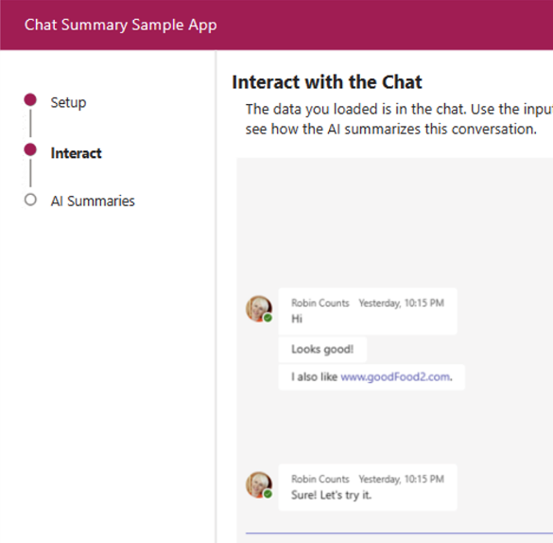
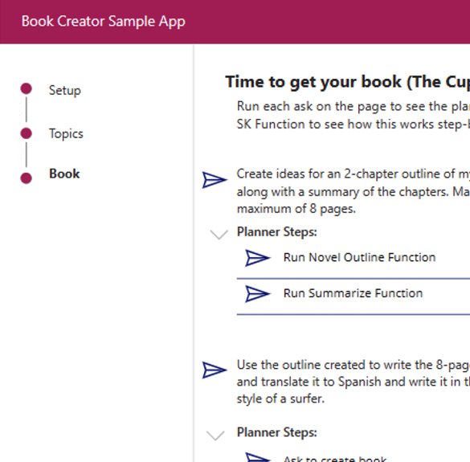
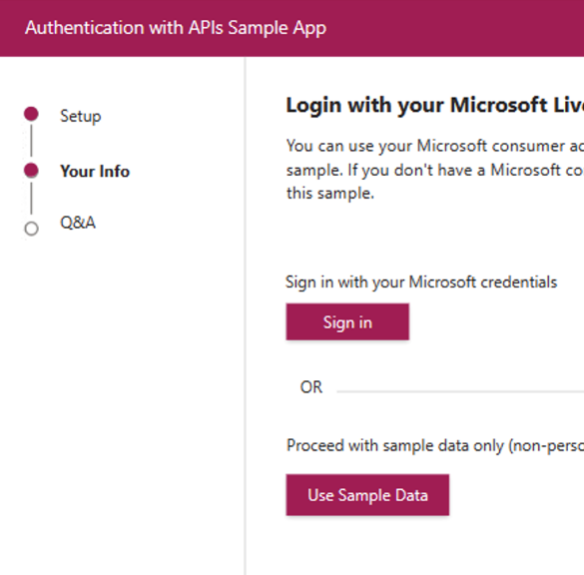
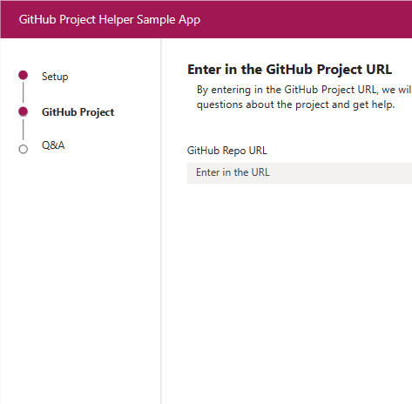
The growing set of samples are designed for most use cases.
Easily add chat-themed AI skills into your app.
Chain prompts serially or hierarchically via Planner.
Query MS Graph information with your favorite prompts.
Chat with your repo of choice using embeddings.
THE CHAT SAMPLE
THE PLANNER SAMPLE
THE MS GRAPH SAMPLE
THE EMBEDDING SAMPLE
FOR 1P DEV + PRODUCT LEADERS

Slide 13
What you can anticipate in response to Semantic Kernel …
At first, I was ???? And then I ran the code. I got it! 😍 Wow.
I’ve been following langchain. 🤔 Can this really compare?
We tend to be bad at shared approaches like this. 😶 Sorry, I’m busy.
—Optimistic Devs / PMs
—Skeptical Data Scientists / PMs
—Hardened Veterans-Who-Ship
FOR 1P DEV + PM LEADERS

Slide 14
How to respond when the detractors are strong:
One-off, LLM AI micro-features sink our future ability to do more.
Without a shared LLM AI approach, multiple-personalities will arise.
Semantic Kernel takes advantage of the latest advances in LLM AI.
Your app(s) will have immediate access to each 10X LLM AI advance.
SK enables the integration of multiple and the next LLM models.
FOR 1P DEV + PRODUCT LEADERS

Slide 15
How can you tell if the SK approach is having an impact?
Divergence is trending down ↓
DIY approaches to deploying LLM AI are losing popularity
Internal sharing is trending up ↑
Awesome stuff is getting built because we’re building smartly
AI-powered feature quality is up ↑
We’re investing in what matters instead of all taming LLM AIs
FOR 1P DEV + PRODUCT LEADERS

Slide 16
Semantic Kernel Home
Internal-Only GitHub Repo
Technical Demonstrations
Technical Support
aka.ms/sk
aka.ms/skrepo-howto
aka.ms/skdemos
aka.ms/sksupport

